Slide 1

The RISK of Markov Chains
A tale of battle, dice, and victory.
Allen Xie

Slide 2


RISK is a classic board game with the objective of eliminating your opponents.
This objective is achieved by conquering all your opponents’ territories, which are decided by battles.

Slide 3
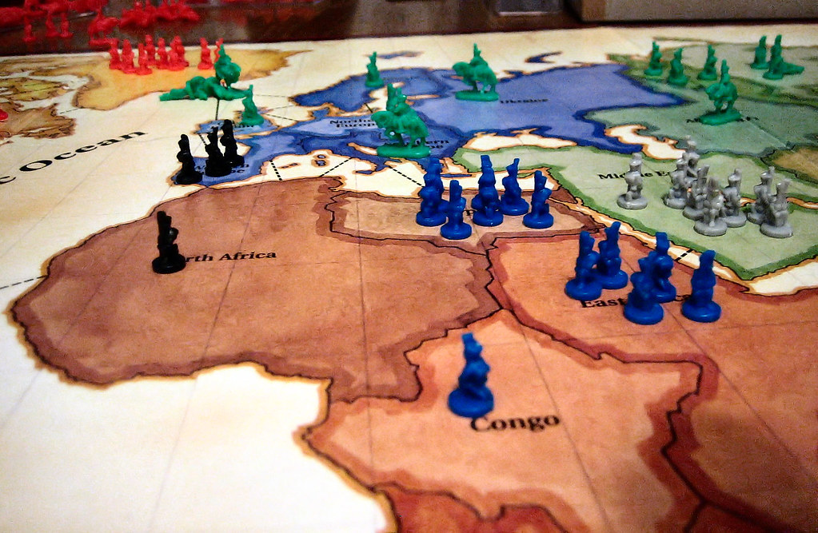
On a player's turn, they may choose to attack an adjacent opponent's territory with an army located in adjacent territory.
The attacking and defending player each have several troops in their army located in their respective territories.
This Photo by Unknown Author is licensed under CC BY

Slide 4

The players then perform a series of battles to determine if the attacked territory is defended or conquered.
Each battle is performed through dice rolls, which determines how many troops are lost in the battle, up to 2 on either side.
The outcome of the attack is determined by the result of all the battles, typically with one side losing all their troops.

Slide 5
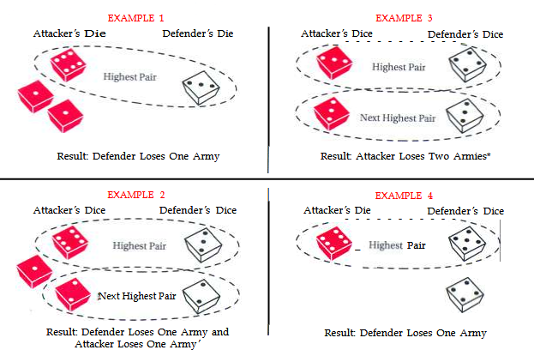
Battle specifics
The attacker chooses one of their territories to attack another with troops stationed at their respective territories to use in battle
Players choose to roll dice <= the number of troops they have, up to 3 for the attacker and 2 for the defender
Compare the highest rolled die from each side, whoever rolled lower loses a troop, with ties favoring the defender
An attack continues until one side has no more troops

Slide 6

Although the probabilities of an individual battle are relatively straight forward to calculate, the probability of conquering a territory is not so clear.
Since the starting conditions of a battle is determined by the results of the previous battle, these conditions can be naturally represented with an absorbing Markov chain.

Slide 7
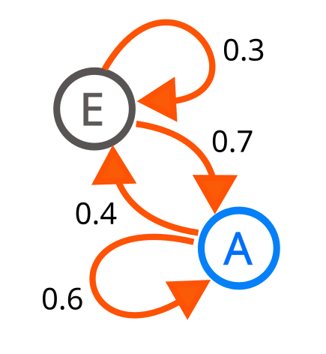
What is a Markov chain?
A type of probabilistic process
Describes a “chain” of possible events, called states.
The probability of the next state is determined by the previous state

Slide 8
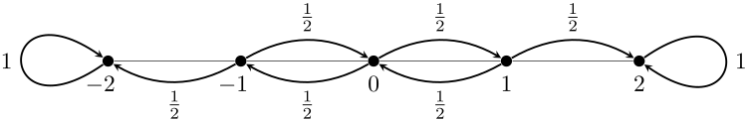
Absorbing Markov chain
A type of Markov chain
Has an “absorbing state” where the “next state” is always itself
All other states eventually leads to an absorbing state
This applies to RISK, as each state is represented by the number of troops on each side, and the absorbing states are the battle outcomes, where one side has run out of troops

Slide 9



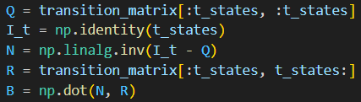
Calculating absorbing probabilities
Create transition Matrix P, which can be split into sections Q, R and I.
Calculate the expected number of visits to a transient state, N.
Calculate the probability of being absorbed into an absorbing state from a transition state, B.
The first row of matrix B contains the steady state probabilities of reaching a specific absorbing state from the original transition state.

Slide 10
Single Roll probabilities
State (Attack, Defend) | Attacker -1 troop |  | Defender -1 troop
(1 Die, 1 Die) | 0.583 |  | 0.416
(2 Die, 1 Die) | 0.421 |  | 0.578
(3 Die, 1 Die) | 0.340 |  | 0.659
(1 Die, 2 Die) | 0.745 |  | 0.254
--- | Attacker -2 troops | Both -1 troop |  | Defender -2 troops
(2 Die, 2 Die) | 0.448 | 0.324 |  | 0.227
(3 Die, 2 Die) | 0.292 | 0.335 |  | 0.371
Equal dice general favor defenders
more dice is always better

Slide 11
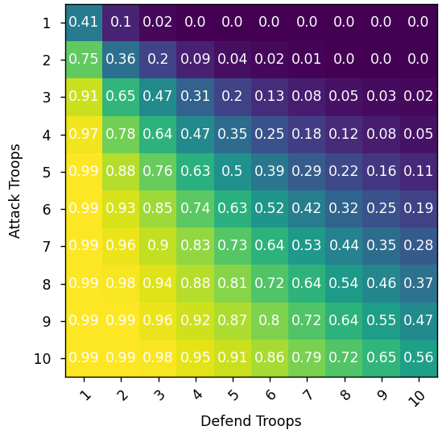
Probability of conquering a territory
Values are truncated to 3 decimal places
Number of troops are the number that can battle (1 attacking troop must stay behind to defend the territory)

Slide 12
Option 2: monte Carlo simulations
Alternative way to calculate the probability
Simulates many random scenarios to estimate probability
Less math intensive than Markov chains
Less accurate than Markov chains

Slide 13
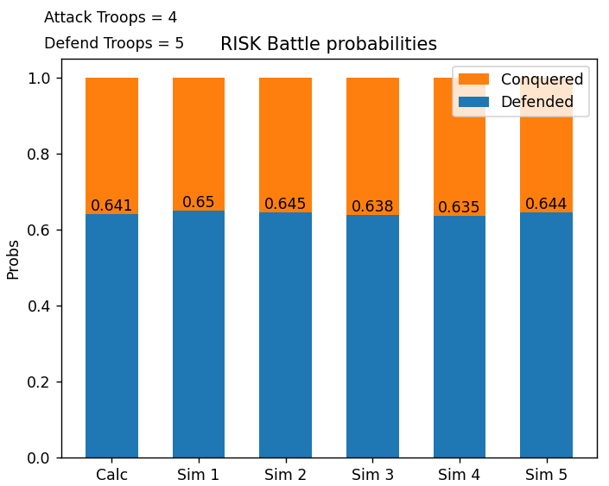
Comparing Monte Carlo and Markov
Each simulation (Sim) ran 10,000 times
While this is for a specific combination of attack/defend troops, other combinations show similar graphs
The simulations tended to be within ~1% of the calculated probability

Slide 14
Credits and sources
https://en.wikipedia.org/wiki/Absorbing_Markov_chain
https://cdn.1j1ju.com/medias/ad/d9/a3-risk-rulebook.pdf
Python, NumPy, MatPlotLib
Scripts: github

